Slide 1
SYED HASAN SAEED
Email: hasansaeedcontrol@gmail.com
Web Page: hasansaeed872726549.wordpress.com
Shasansaeed.yolasite.com

Slide 2
OUTLINE
Introduction to Analogous System.
Force-Voltage Analogy.
Force-Current Analogy.
Example on Analogous System.
Mechanical Equivalent Network.

Slide 3
BOOKS
AUTOMATIC CONTROL SYSTEM: KUO & GOLANARAGHI
2. CONTROL SYSTEM: ANAND KUMAR
3. AUTOMATIC CONTROL SYSTEM: S. HASAN SAEED
ELECTRICAL MACINE & AUTOMATIC CONTROL: J.B.GUPTA & S. HASAN SAEED
AUTOMATIC CONTROL SYSTEM: R. A . BARAPATE

Slide 4
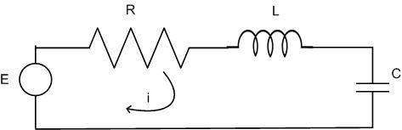
ANALOGOUS SYSTEM
Apply KVL in Series RLC Circuit
aaanna

Slide 5
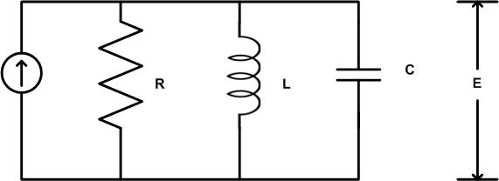
Consider parallel RLC circuit and apply KCL
I

Slide 6
We know the equation of mechanical system
Compare equation(5) with equation(2)
FORCE –VOLTAGE ANALOGY (f-v)
S.NO. | TRANSLATIONAL SYSTEM | ELECTRICAL SYSTEM
1. | Force (F) | Voltage (E)
2. | Mass (M) | Inductance (L)
3. | Stiffness (K), Elastance (1/K) | Reciprocal of C, Capacitance (C)
4. | Damping coefficient (B) | Resistance (R)
5. | Displacement (x) | Charge (q)

Slide 7
Compare equation (5) with equation (4)
FORCE-CURRENT ANALOGY
S.NO. | TRANSLATIONAL SYSTEM | ELECTRICAL SYSTEM
1. | Force (F) | Current (I)
2. | Mass (M) | Capacitance (C)
3. | Damping coefficient (B) | Reciprocal of resistance (1/R) i.e conductance (G)
4. | Stiffness (K), Elastance (1/K) | Reciprocal of inductance (1/L)
5. | Displacement (x) | Flux linkage (φ)
6. | Velocity | Voltage (E)

Slide 8
For rotational system
Torque-voltage (T-V) analogy
Compare equation(2) with equation (6)
S.NO. | ROTATIONAL SYSTEM | ELECTRICAL SYSTEM
1. | Torque (T) | Voltage (E)
2. | Moment of inertia (J) | Inductance (L)
3. | Damping coefficient (B) | Resistance (R)
4. | Stiffness (K), Elastance (1/K) | Reciprocal of capacitance (1/C). Capacitance (C)
5. | Angular displacement (θ) | Charge (q)
6. | Angular velocity (ω) | Current (I)

Slide 9
Compare equation (4) with equation (6)
TORQUE(T)-CURRENT (I) ANALOGY
S.NO. | ROTATIONAL SYSTEM | ELECTRICAL SYSTEM
1. | Torque (T) | Current (I)
2. | Moment of inertia (J) | Capacitance (C)
3. | Damping coefficient (B) | Reciprocal of resistance (R), conductance (G)
4. | Stiffness (K), Elastance (1/K) | Reciprocal of inductance (1/L)
5. | Angular displacement (ω) | Flux linkage (φ)

Slide 10
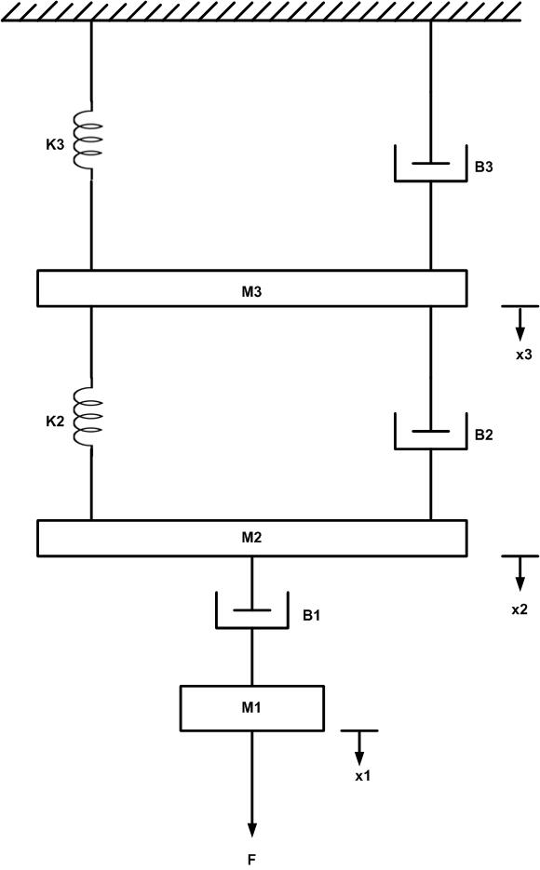
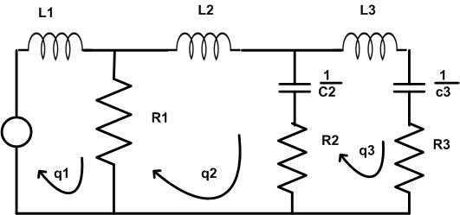
Draw the analogous electrical network of the given fig. using f-v analogy
V

Slide 11
MECHANICAL EQUIVALENT NETWORK
PROCEDURE TO DRAW THE MECHANICAL EQUVALENT NETWORK:
Step 1: Draw a reference line.
Step 2: Corresponding to the displacement x₁ x₂ ….select the nodes.
Step 3: Connect one end of masses to the reference line
Step 4: Connect other elements of the system to the nodes.
Step 5: Apply nodal analysis, write the system equations.

Slide 12
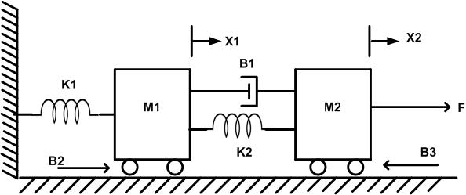
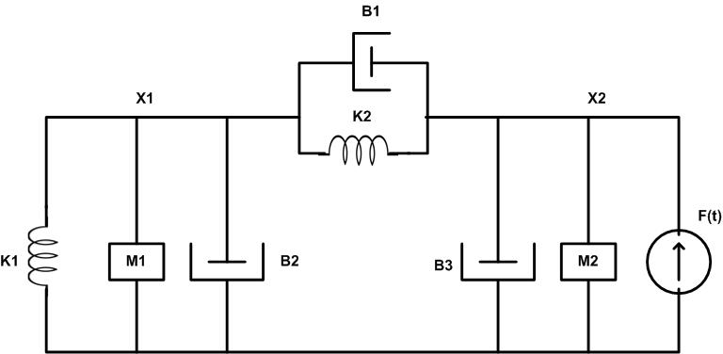
Example: (i) Draw the mechanical network of the given system (ii) Draw the analogous electrical system use f-i analogous(assume wheels are frictionless).

Slide 13
Analogous Circuit (f-I analogy)
1/R₁ (B₁)
1/L₂ (K₂)
1/L₁
(K₁)
C₁
(M₁)
C₂
(M₂)
i(t)
f(t)

Slide 14
f-v analogy
L₂
L₁
q₁
R₁
q₂
V
1/C₁
1/C₂
R₃
R₂

Slide 15
THANK YOU FOR YOUR ATTENTION

